Slide 1
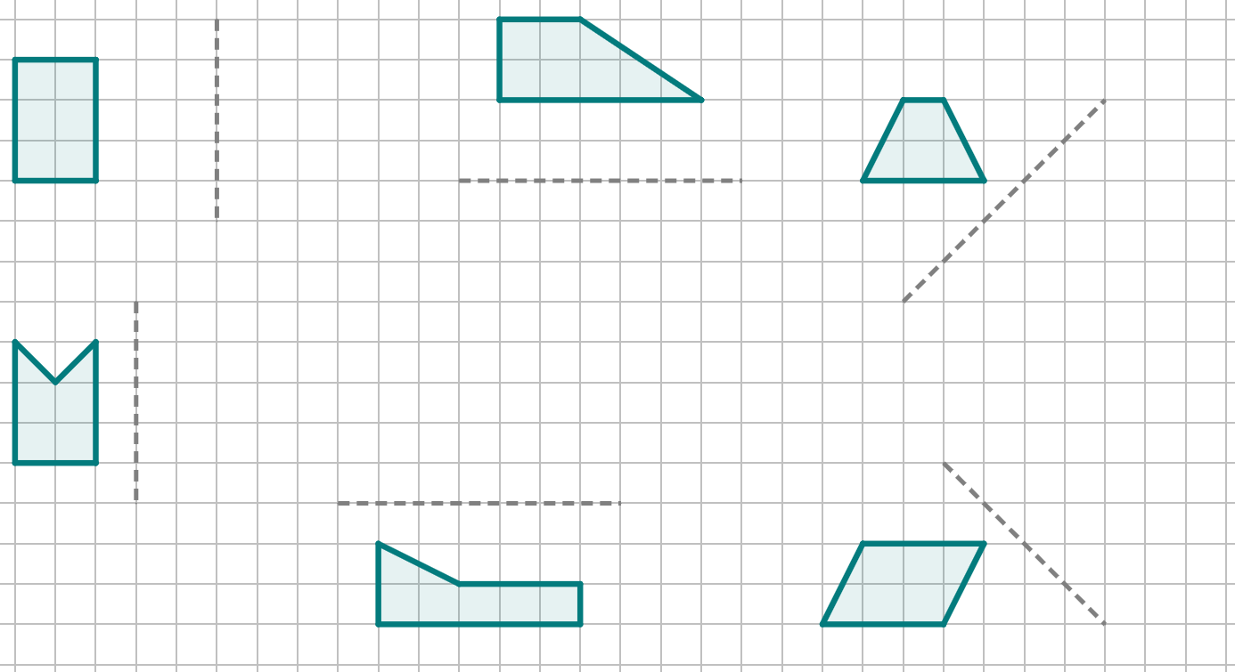
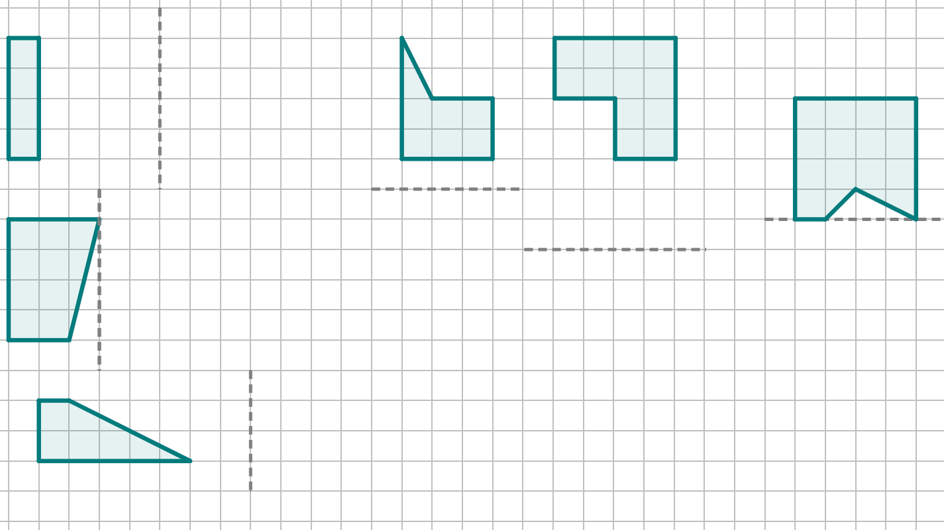
Reflecting objects
Task A: Using tracing paper to reflect objects
1) Reflect each of these objects in the line of reflection closest to it. You must use tracing paper.
Task B: Counting squares to reflect objects
1) Reflect each of these objects in the line of reflection closest to it. Do not use tracing paper.

Slide 2
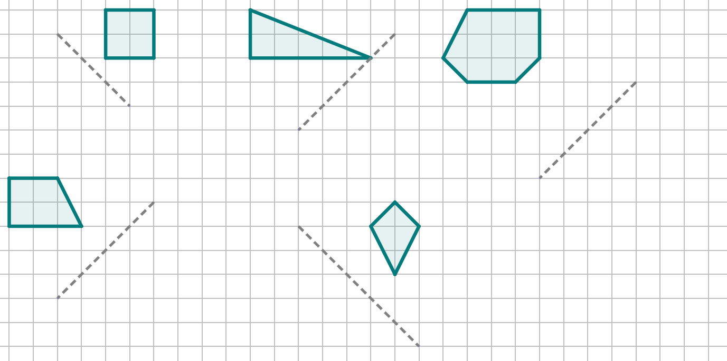
Reflecting objects
Task C: Counting squares to reflect objects diagonally
1) Reflect each of these objects in the line of reflection closest to it. Do not use tracing paper.
Mathematics in Education and Industry
v2.1

